Slide 1
Automated Restaurant

Slide 2
Introduction
- The Frequent growth of wireless technology and Mobile devices in this era is creating a huge impact on our lives. Some early efforts have been made to combine and utilize both of these technologies in advancement of hospitality industry. This research work aims to automate the food ordering process in restaurant and also improve the dining experience of customers. In this paper we discuss about the design & implementation of automated food ordering system with real time for restaurants. This system, implements wireless data access to servers. The android application on user’s mobile will have all the menu details. The order details from customer’s mobile are wirelessly updated in central database and subsequently sent to kitchen and cashier respectively. The restaurant owner can manage the menu modifications easily. The wireless application on mobile devices provides a means of convenience, improving efficiency and accuracy for restaurants by saving time, reducing human errors. At the kitchen department, the order will display at the kitchen's screen

Slide 3
Components:

Slide 4

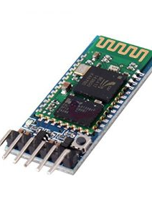
1. HC-05 -Bluetooth to Serial Port Module
HC-05 module is an easy to use Bluetooth SPP (Serial Port Protocol) module, designed for transparent wireless serial connection setup. Serial port Bluetooth module is fully qualified Bluetooth V2.0+EDR (Enhanced Data Rate) 3Mbps Modulation with complete 2.4GHz radio transceiver and baseband.

Slide 5
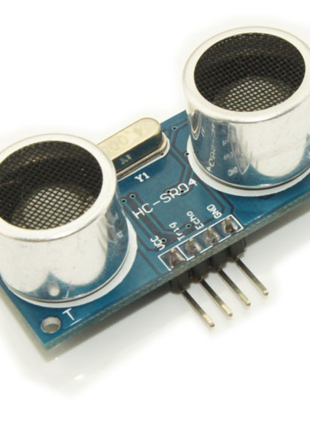
2.Ultrasonic Module
The ultrasonic sensor works on the principle of SONAR and RADAR system which is used to determine the distance to an object.
An ultrasonic sensor generates the high-frequency sound (ultrasound) waves. When this ultrasound hits the object, it reflects as echo which is sensed by the receiver as shown in below figure.

Slide 6
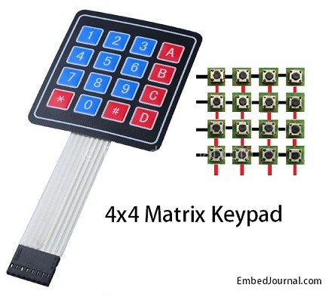
3.Keypad matrix
A computer keyboard usually has a small numeric keypad on the side, in addition to the other number keys on the top, but with a calculator-style arrangement of buttons that allow more efficient entry of numerical data. This number pad (commonly abbreviated to "numpad") is usually positioned on the right side of the keyboard because most people are right-handed.

Slide 7
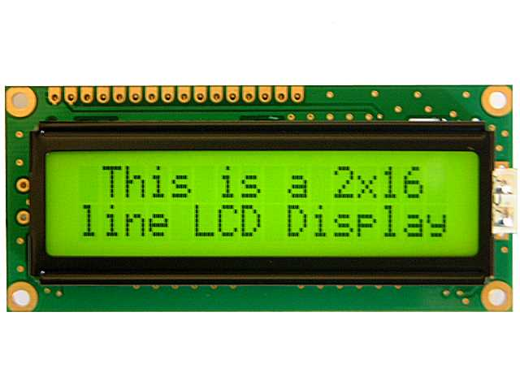
4. 16X2 LCD
LCD (Liquid Crystal Display) screen is an electronic display module and find a wide range of applications. A 16x2 LCD display is very basic module and is very commonly used in various devices and circuits. These modules are preferred over seven segments and other multi segment LEDs. The reasons being: LCDs are economical; easily programmable; have no limitation of displaying special & even custom characters (unlike in seven segments), animations and so on.

Slide 8
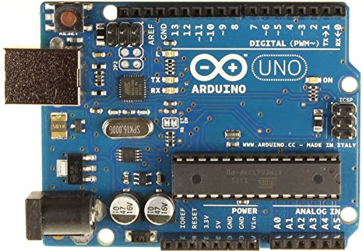
Arduino
Arduino is an open source computer hardware and software company, project, and user community that designs and manufactures single-board microcontrollers and microcontroller kits for building digital devices and interactive objects that can sense and control objects in the physical world.

Slide 9
Working
As a customer would enter our restaurant, he would first approach the Welcome board which would show the map of the restaurant and indicate whether or not the respective table has been booked. As a customer goes to a table and lifts the menu card, the welcome board gets updated and the table is shown to be booked. There is a keypad given to the customer in which he could place the order to the chef. Now, the chef would get the order on his phone. The chef would now estimate the time required for the delivery of the order, which would get updated on the common LCD placed in the restaurant.

Slide 10
Presented by:
Sanchi Prakash
Harshit Agarwal
Nayan Garg

